Slide 1

Beers & Breweries
DDS Fall Case Study 1 - Krithika Kondakindi, Jack Kortokrax, Michael Schulte

Slide 2
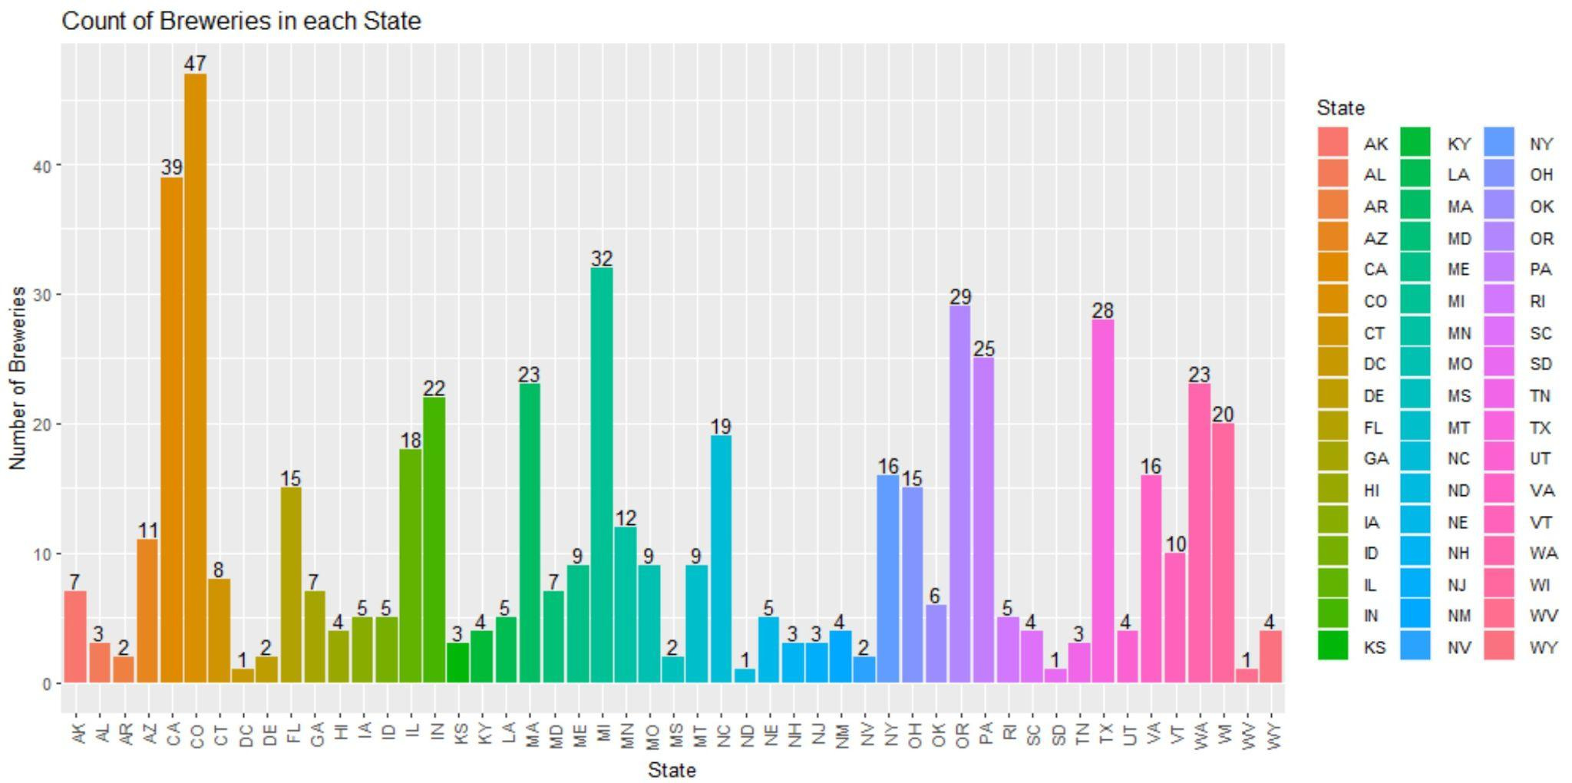
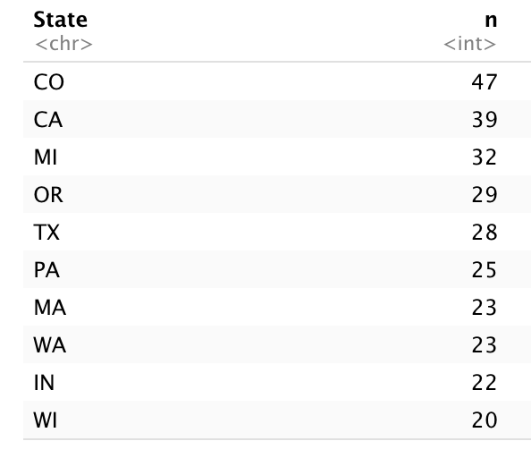
Count of Breweries in each State
Top 10 States with most Breweries

Slide 3
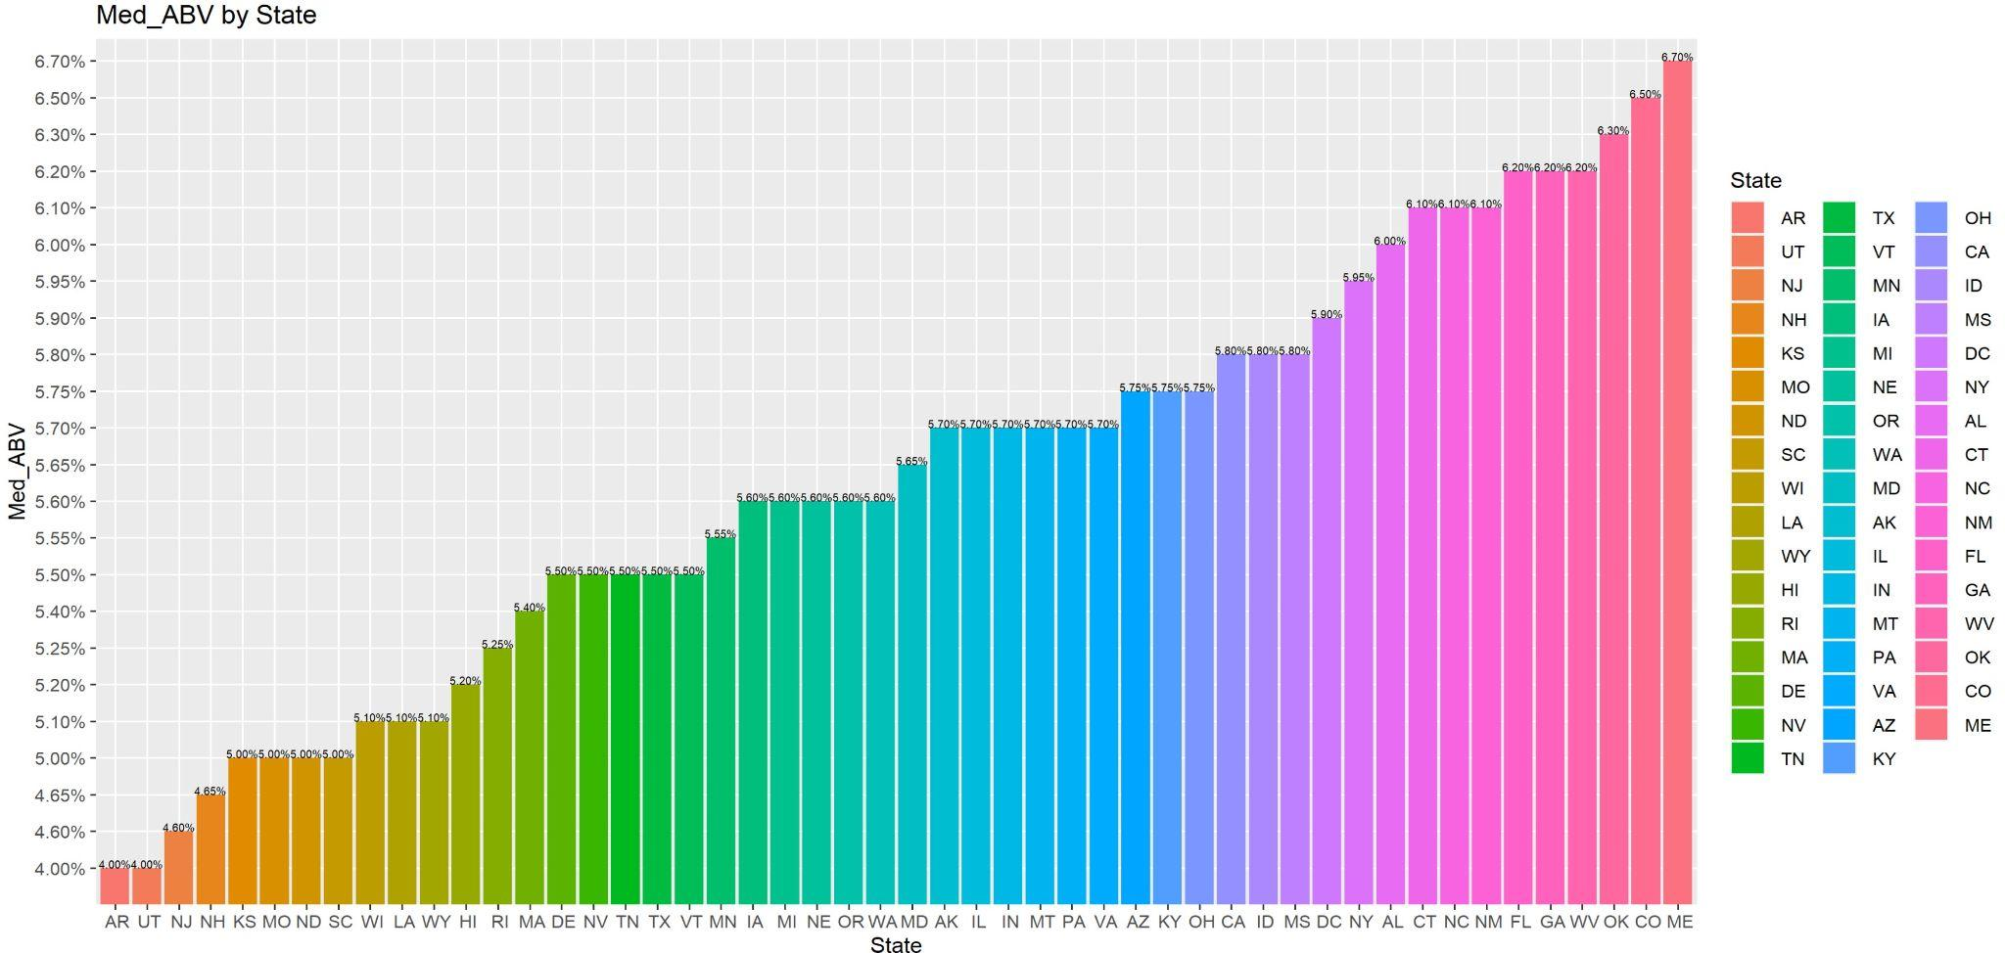
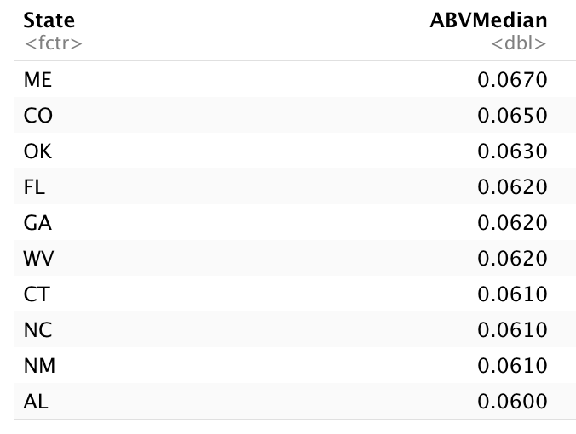
Median Alcohol By Volume (ABV) by State
Top 10 States with highest Median ABV
Top 10 Highest Median ABV by State: Maine, Colorado, Oklahoma, Florida, Georgia, West Virginia, New Mexico, North Carolina, Connecticut, Alabama

Slide 4
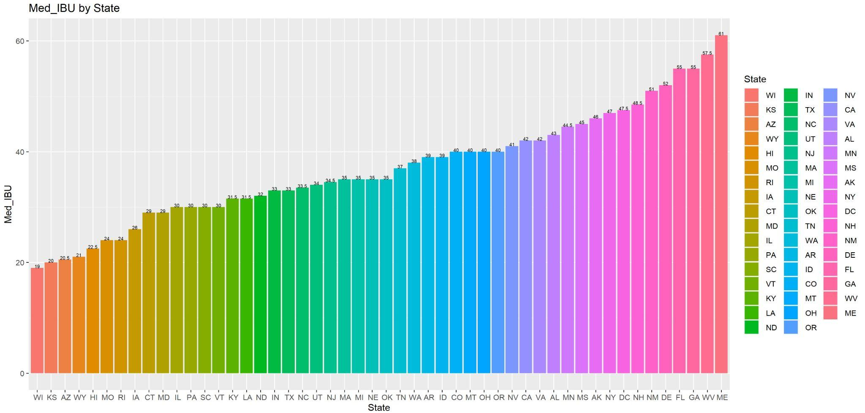
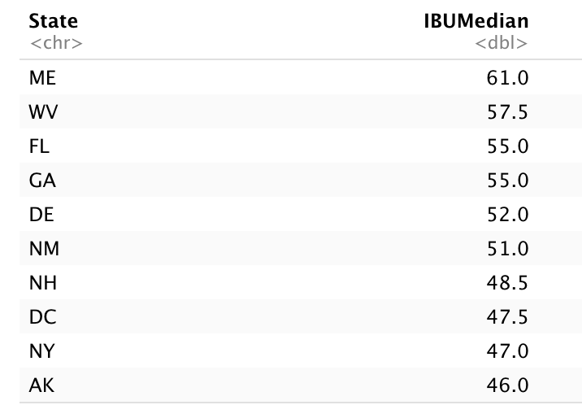
Median International Bitterness Unit (IBU) by State
Top 10 States with highest Median IBU
Top 10 Highest Median ABV by State: Maine, West Virginia, Florida, Georgia, Delaware, New Mexico, New Hampshire, Washington D.C., New York, Arkansas

Slide 5
Max ABV & IBU
Max ABV State: CO - “Upslope Brewing Company”
Max IBU State: OR - “Astoria Brewing Company”

Slide 6
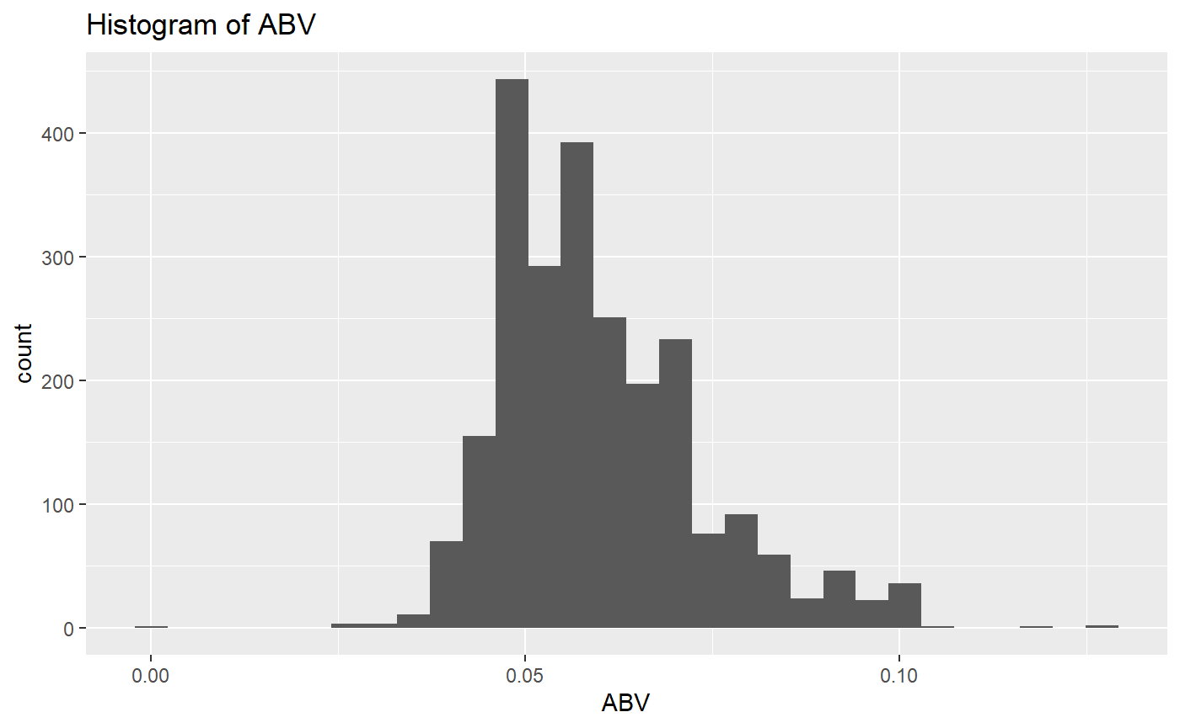
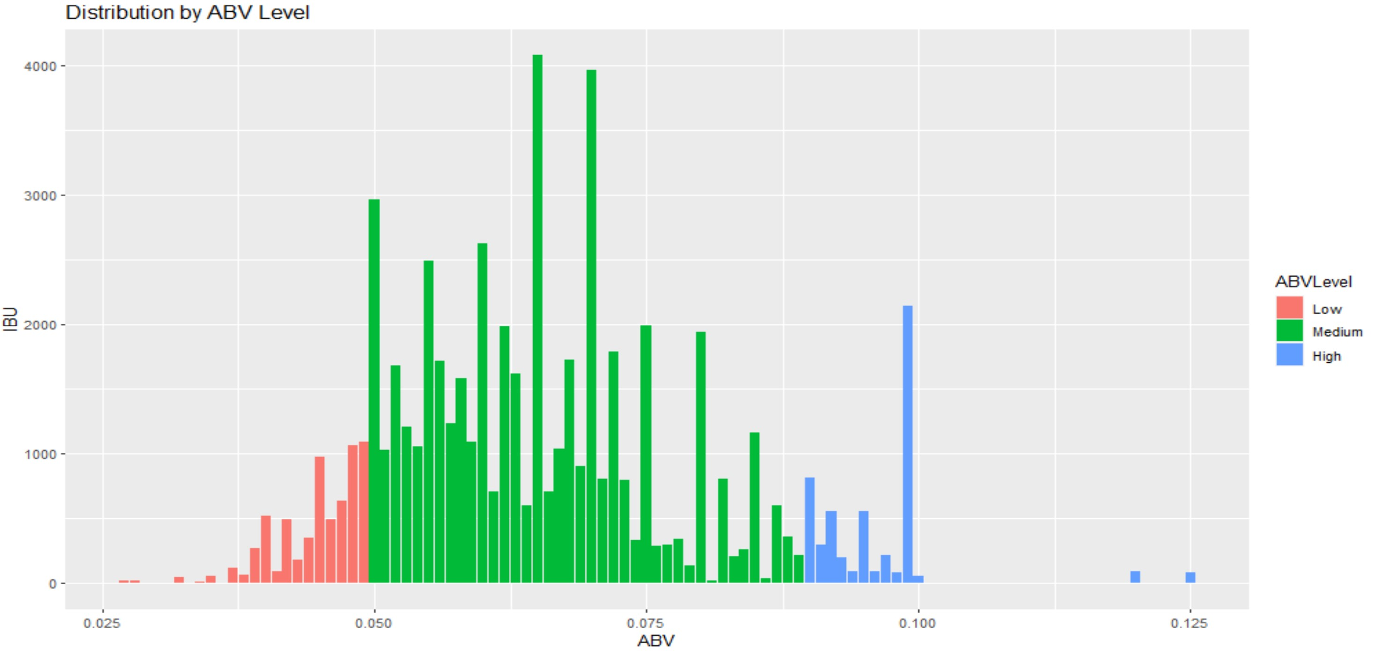
ABV - Statistics & Distribution
Summary Statistics:
Min = .001 or .1%
Max= .128 or 12.8%
1st Quartile= .05 or 5%
Median= .0565 or 5.65%
3rd Quartile= .067 or 6.7%
Distribution of the ABV is slightly skewed to the right.

Slide 7
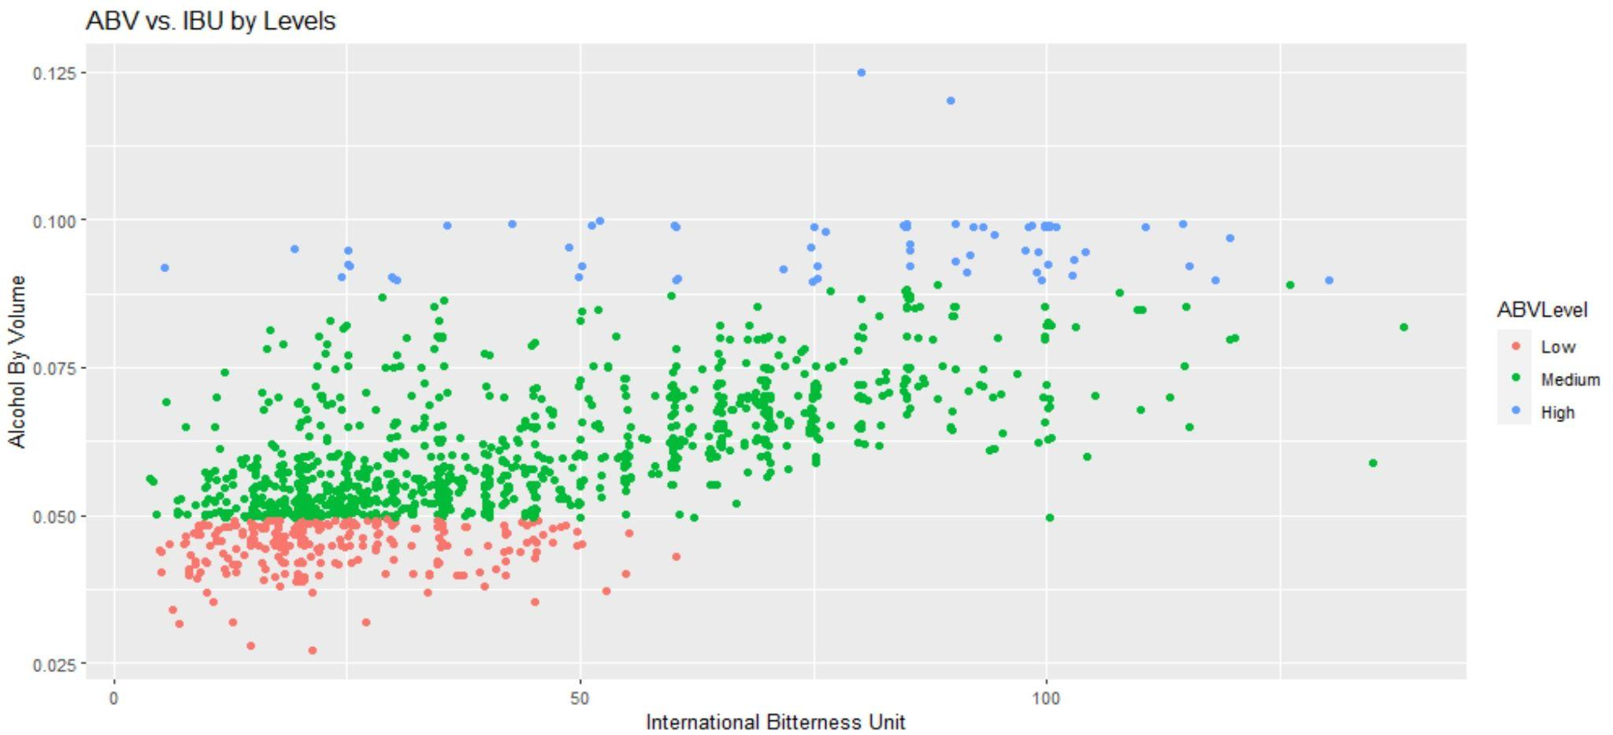
ABV vs. IBU
Legend Measure - - Low(.00 to .049), Medium(.05 to .089), High(.09 to .13), No N/A values included

Slide 8
Ale’s and IPA’s: Can we identify the difference using ABV, IBU and Beer Names?
The first step we took to achieve an accurate measure was to impute the mean ABV and IBU for beers with NA values by taking the mean of each Style of beer. Those that could not be calculated where given a value of zero.

Slide 9
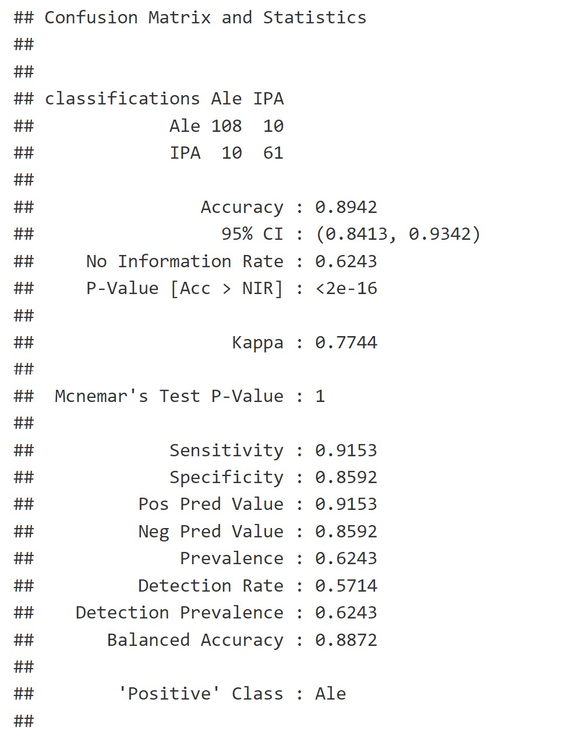
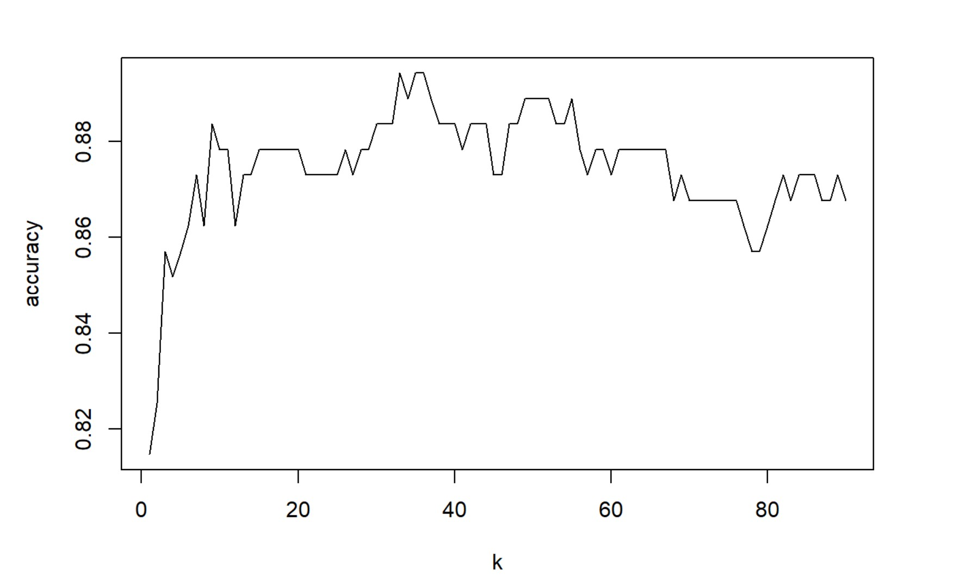
K-Nearest Neighbors Test For Ale’s and IPA
Visualization of KNN Test
Set.Seed(200)
Max KNN of 36, with Max Accuracy of .8942 or 89.42%

Slide 10
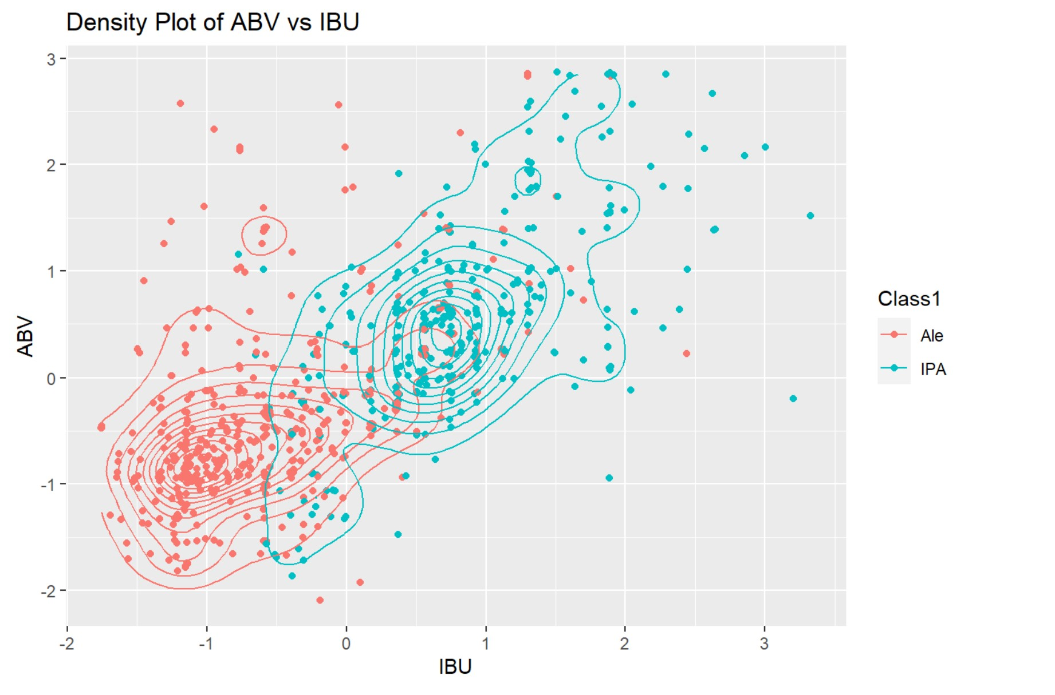
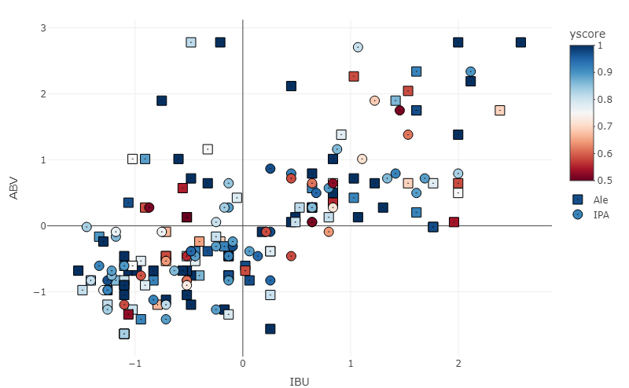
Predicting ABV and IBU based on Name Types
Scatter Plot Displaying the Predicted Types
Visualization of Predicted Analysis for Ale and IPA types. Graphs display the probable grouping distribution based on confidence interval testing.

Slide 11
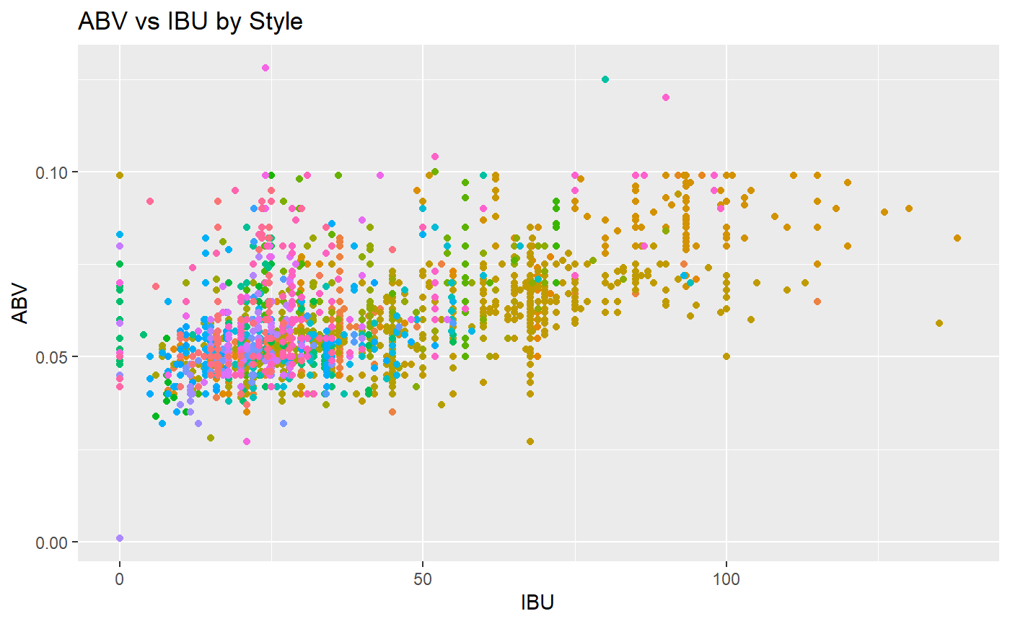
Predicting ABV and IBU based on Name Types
There is significant evidence to prove that at least one Style has a different IBU, and one style has a different ABV (p-value < 2e-16).
Each color represents a different type of beer. Suggesting types have specific ABV and IBU associated with them.

Slide 12
Summary
Looked at top ten states to track our most saturated or under saturated markets.
Found that the highest median values for ABV and IBU comes from Maine.
Certain states prefer different types of beer?
By finding the distribution of predicted types we can holistically look at the data by Beer type. This data is useful since it provides us with more understanding of the existing market and where our best opportunities to enter the market may be. This data can support research and development teams to pursue the next steps in entering the markets; such as gathering popularity statistics, predicting cost and revenue, and developing a strategy to meet the company’s goals and values.

